Slide 1
Agri-Nature Entrepreneurship
Planning provisions

Slide 2
Planning provisions
Mariposa County General Plan
Mariposa County Code
Permits

Slide 3
Planning provisions
General Plan = POLICIES
Actions & decisions must be consistent with the General Plan
Refer to General Plan for guidance
Adopted 2006
What is the County’s VISION for the next 20 years?

Slide 4
Planning provisions
General Plan = POLICIES
Actions & decisions must be consistent with the General Plan
What is the County’s VISION for the next 20 years?
County Ordinances = REGULATIONS
What can I do on my land?
What standards or requirements apply to my project (development or use)?

Slide 5
Planning provisions
General Plan = POLICIES
Actions & decisions must be consistent with the General Plan
What is the County’s VISION for the next 20 years?
County Ordinance = REGULATIONS
What can I do on my land?
What standards or requirements apply to my project?
PERMITS
Build or develop
Operate
Allow people to stay
Collect taxes
Cook/Serve Food
Sell products

Slide 6
Planning provisions
General Plan = POLICIES
Actions & decisions must be consistent with the General Plan
County Ordinance = REGULATIONS
What can I do on my land?
What standards or requirements apply to my project?
PERMITS
Build or develop
Operate
Allow people to stay
Collect taxes
Cook/Serve Food
Sell product s

Slide 7
Mariposa County General plan
ISSUES = Economy + Character + Housing
____________________________________________________
Rural Character
Maintain Rural Character
Property Rights
Highest and Best Use while Using Property Responsibly
Protect Agriculture
Maintain agricultural/working landscapes (food, fiber and timber production)
Sustainable and Diverse Economy
Businesses, services and industries need properly zoned sites

Slide 8
Planning provisions
General Plan = POLICIES
Actions & decisions must be consistent with the General Plan
County Ordinance = REGULATIONS
What can I do on my land?
What standards or requirements apply to my project?
PERMITS
Build or develop
Operate
Allow people to stay
Collect taxes
Cook/Serve Food
Sell product s

Slide 9
County ordinances
ZONING ORDINANCE
Map – Every parcel is assigned Zoning Designation

Slide 10
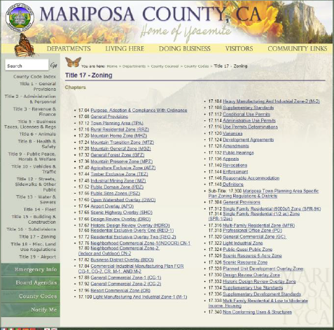
County ordinances
ZONING ORDINANCE
Zoning Designations
Regulations establish:
Uses allowed or
conditionally allowed
Uses prohibited
Permits
Development standards
Minimum parcel size

Slide 11
Parcel zoning
Mountain Preserve
Mountain General
Public Domain
Agriculture Exclusive

Slide 12
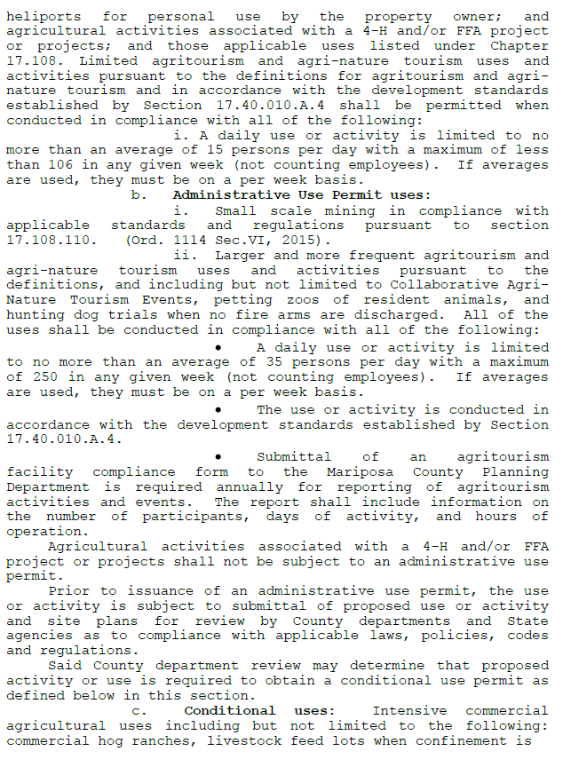
Agriculture exclusive

Slide 13
Proposed Project
Use:
Permitted
Permitted with Administrative Use Permit
Conditionally Permitted
Prohibited
Development Standards
Permits

Slide 14
Zoning: General use standards
17.108.060 General use standards.
…the following land uses shall be permitted:
A. Agricultural uses, including:
animal husbandry
livestock grazing
production of crops
horticulture
viticulture
silviculture
sale of agricultural products
accessory uses and structures appurtenant to the agricultural use (barn, winery)
…
Must be operated in a manner consistent with proper and accepted customs, standards, and practices…
Cannot be a nuisance…

Slide 15
Zoning: general use standards
17.108.060 General use standards.
…the following land uses shall be permitted:
Home enterprises shall be a permitted use in the RR, MH, MT, MG, GF, MP, and AE zones:
On site sales - limited to sale of products fabricated or produced on site
No more than 1 employee per acre up to 20 employees
Must be operated by owner of business – must reside on property on permanent basis
Use and its principal activities are conducted primarily within structures or dwellings:
1. No outdoor storage and no more than ten percent (10%) of the total business activity is conducted outside;
2. Exterior use and facilities must be 50 feet from all property lines, streets, roads, or other public right-of-ways

Slide 16
Zoning: general use standards
17.108.060 General use standards.
…the following land uses shall be permitted:
Rural home industry is permitted use in the same zones as home enterprise except not in RR:
trades or industries of a limited character
not detrimental to adjoining residential areas, by reason of appearance, noise, dust, smoke, or odor.
Subject to the same standards specified for a home enterprise, except
outside storage is allowed if storage is not visible from external property lines, streets, roads

Slide 17
Zoning: general use standards
17.108.060 General use standards.
…the following land uses shall be permitted in all principal zones (limits for AE zone):
Bed and breakfast and vacation rentals.
Rent home (vacation rental) or individual bedrooms in home (bed and breakfast)
Limit number of bedrooms
Limit occupants
Water testing / septic system certification
Building and fire safety standards
Parking standards
Inspection process

Slide 18
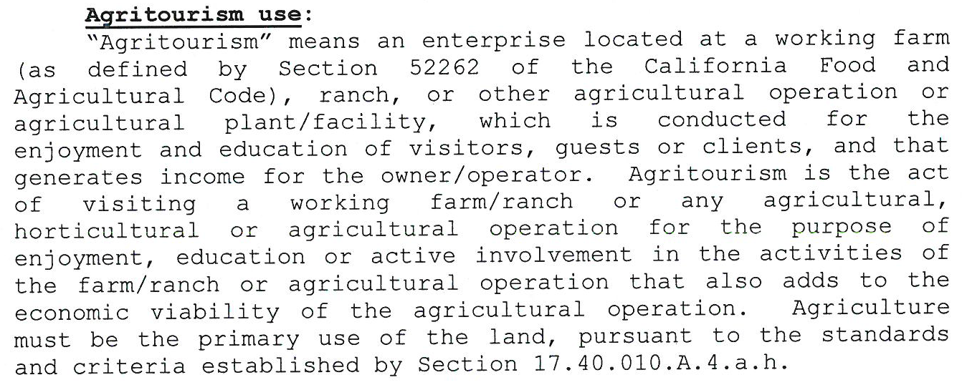
Zoning – ae zone
AgriTourism Uses

Slide 19
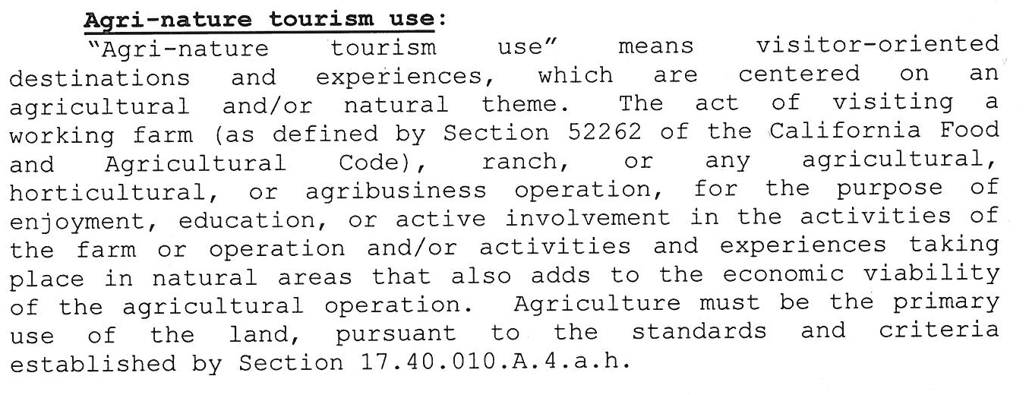
Zoning – ae zone
AgriNature Tourism Uses

Slide 20
Zoning – ae zone
Agricultural Homestay:

Slide 21
Events venues
Not allowed in rural zones
Events may be conducted as “special event” through the Public Assemblage Permit process
Civil War Re-enactment
Carter Ranch Music Festival

Slide 22
Planning provisions
General Plan = POLICIES
Actions & decisions must be consistent with the General Plan
County Ordinance = REGULATIONS
PERMITS
Build or develop
Operate
Allow people to stay
Collect taxes
Cook/Serve Food
Sell product s

Slide 23
Right to agricultural activity ordinance
Ordinance to enhance and encourage ag operations
Recognizes that where non-agricultural land uses extend into agricultural areas or exist side by side, agricultural operations frequently become the subject of nuisance complaints
Protects existing ag operation, if the operation is in place for one year or more, and it wasn’t a nuisance during that first year
Ag operation must be conducted in accordance with accepted customs, standards and practices

Slide 24
Planning provisions
General Plan = POLICIES
Actions & decisions must be consistent with the General Plan
County Program (State Law)

Slide 25
Williamson Act
Voluntary program
Support commercial agricultural operations
Available AE Zone
Property owner agrees to long term use land for commercial agricultural purposes in exchange for:
use and development restrictions
lower property taxes
Residences – occupied by persons engaged in ag activity
Recreational activities – cannot involve permanent structures (no overnight stays by visitors)
20 year rolling contract

Slide 26
Planning provisions
General Plan = POLICIES
Actions & decisions must be consistent with the General Plan
County Ordinance = REGULATIONS
What can I do on my land?
What standards or requirements apply to my project?
PERMITS
Build or develop
Operate
Allow people to stay
Collect taxes
Cook/Serve Food
Sell products

Slide 27
permits
Grading permit
Building permit
Well or Septic permit
Encroachment permit
Vacation Rental or B&B permit (TOT Certificate)
Administrative Use Permit
Conditional Use Permit
Food Facility Permit to Operate
Organic Registration (Ag Commissioner)
Bee Registration (Ag Commissioner)
Public Assemblage Permit (temporary events – 250 persons or more)
Fictitious Business Name (County Clerk)

Slide 28
Agri-Nature Entrepreneurship
questions

