Slide 1
UC. Cooperative Extension An engine for problem solving in California
Fadzayi Elizabeth Mashiri Ph. D.
UCCE County Director – Mariposa County
Livestock and Natural Resources Advisor – Mariposa, Merced Counties

Slide 2
UC system structure UC ANR, UCCE

Slide 3
University of California Cooperative Extension (UCCE)
Funded by 3 sources:
UC
USDA Cooperative Funding
County
Program in the UC Division of Agriculture and Natural Resources
Work closely with 3 UC Campuses
We can collaborate with any UC, CSU, University, College in our local communities, nationwide or internationally

Slide 4
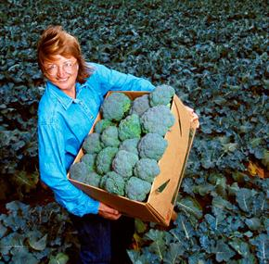
UC ANR Strategic Vision
ANR envisions a thriving California in 2025 where healthy people and communities, healthy food systems, and healthy environments are strengthened by a close partnership between the University of California and its research and extension programs and the people of the state.

Slide 5
How UCCE brings solutions to local communities
Bridge between local issues and the power of UC Research.
Bring practical, science-based answers to Californians’ problem.
Works with industry to enhance agricultural markets, address environmental concerns, and provide producers with scientifically tested production techniques and increased food safety.

Slide 6
How UCCE brings solutions to local communities
200 locally based Cooperative Extension advisors and specialists
57 local offices throughout California
130 campus-based Cooperative Extension specialists
9 Research and Extension Centers
6 statewide programs
700 academic researchers in 40 departments at 3 colleges and 1 professional school

Slide 7
Extension Programs in Mariposa
4-H Program
Donna Wice – Prog Coordinator
Russell Hill – 4-H Advisor
Master Gardener Program
Sheri Mace
Livestock and Natural Resources Prog
Fadzayi Mashiri
Viticulture Program
Karl Lund
California Naturalist Program
Collaborate with UCM

Slide 8
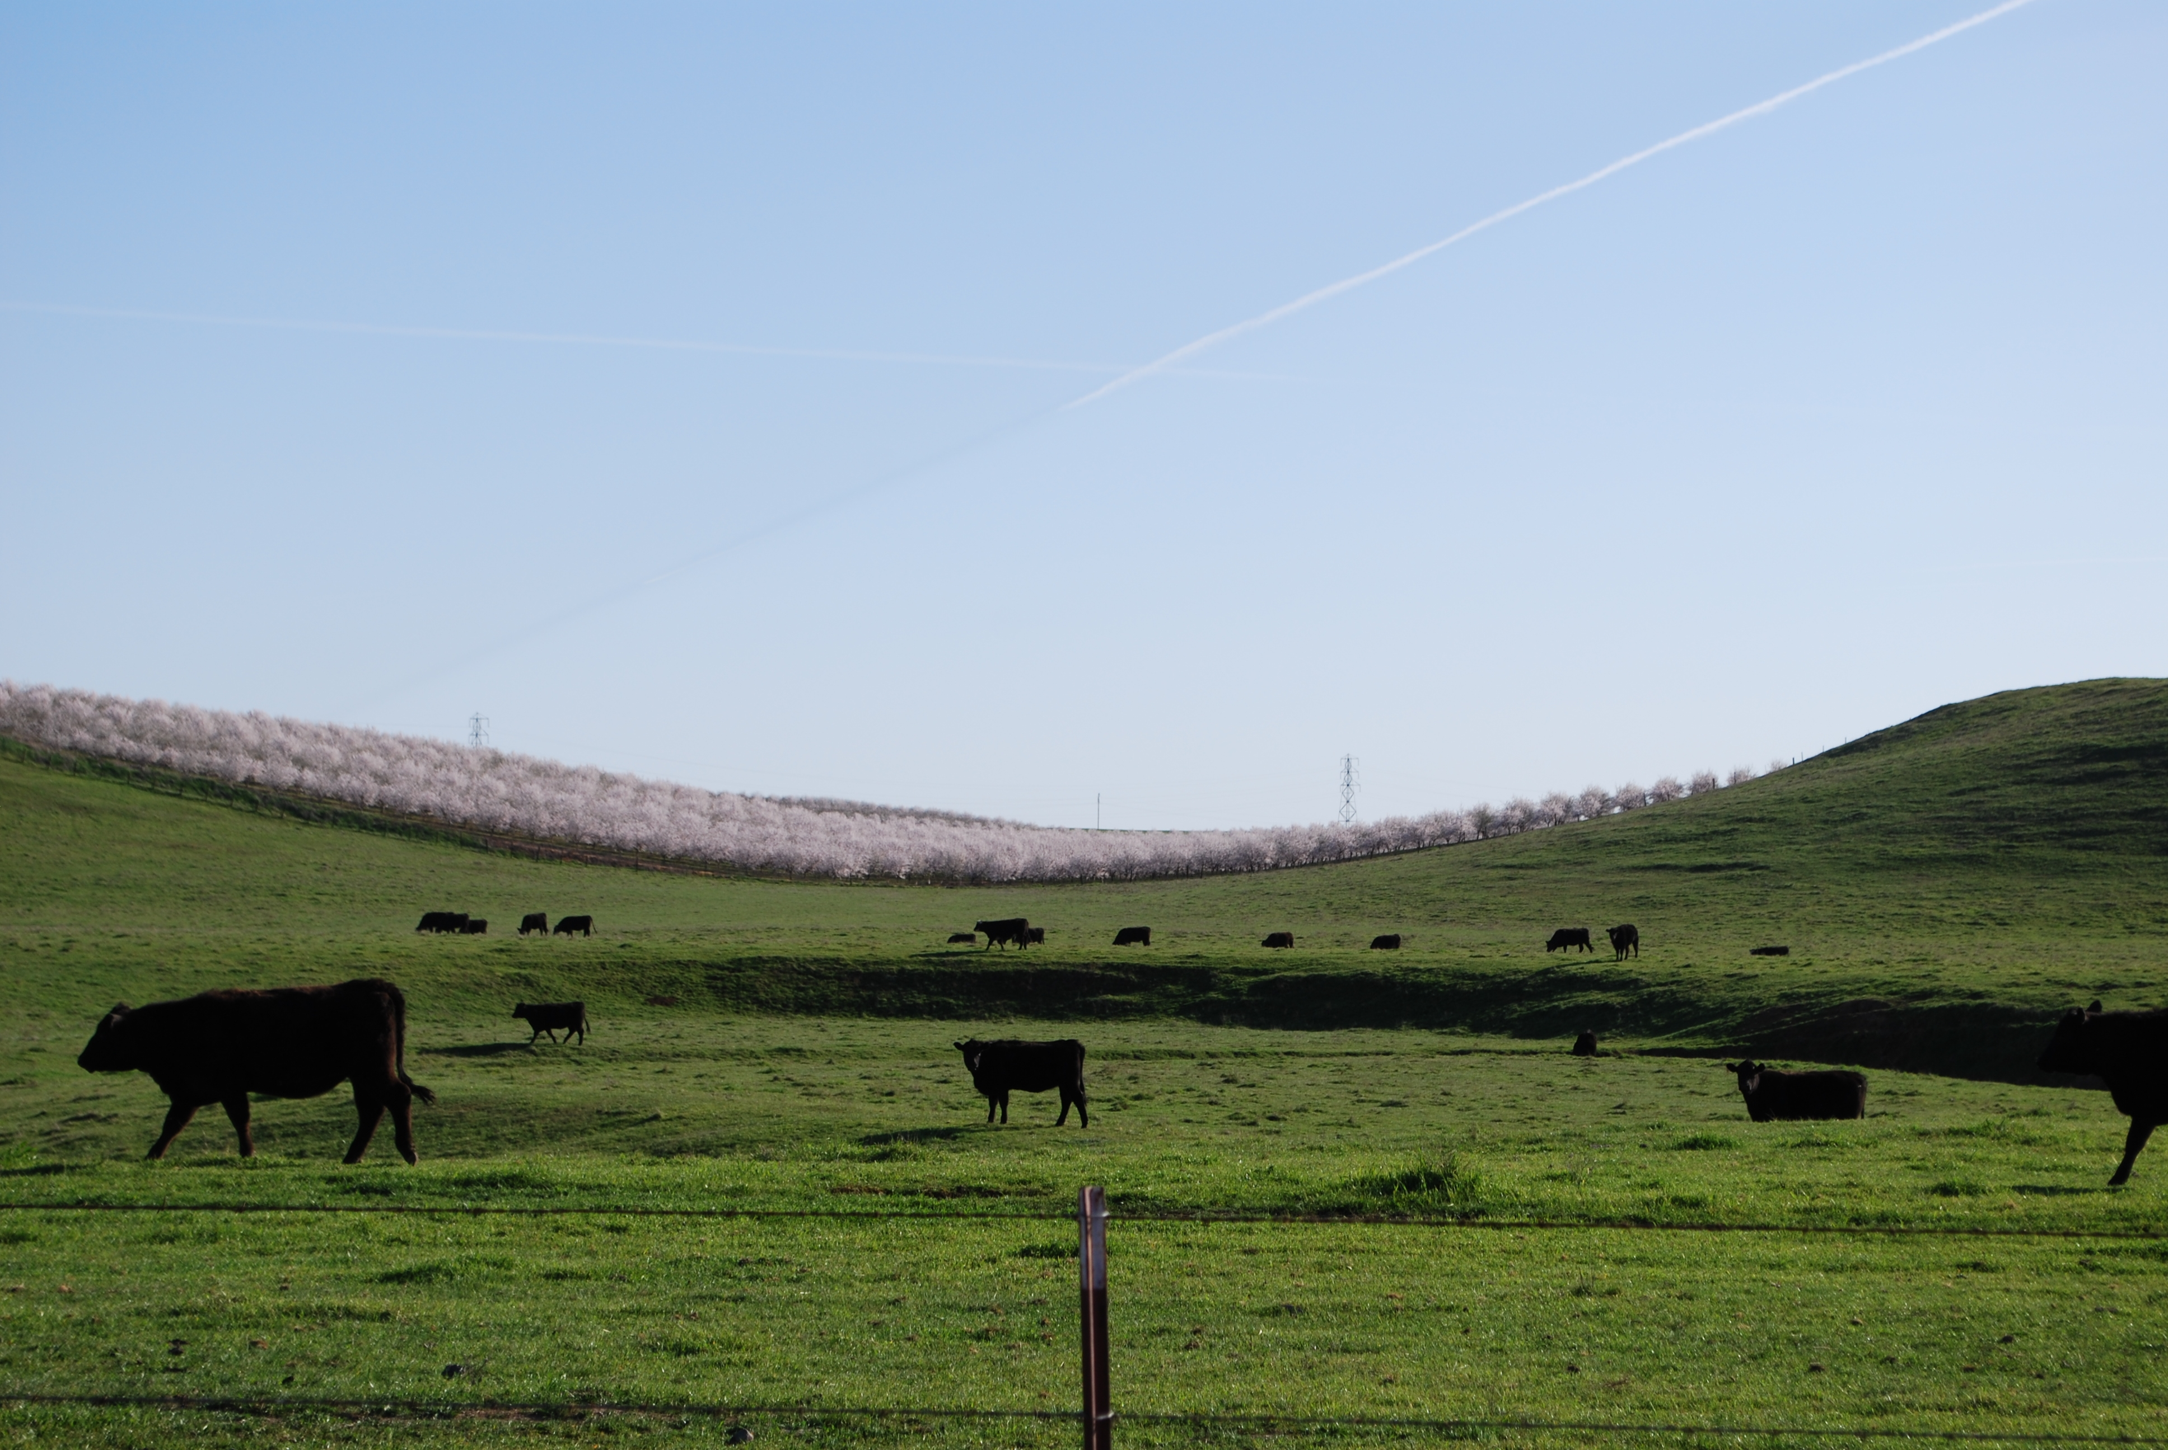
The Role of an Advisors/Coordinators
Develop research programs
Implement extension or educational programs
Ensure programs promote productivity and sustainable ecosystems and are relevant to community needs
Develop citizenship, leadership, responsibility and life skills of youth
Develop and strengthen linkages between science based information and communities

Slide 9
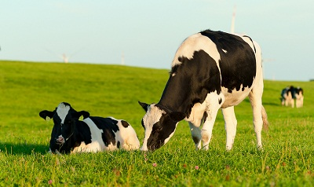
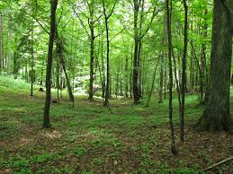
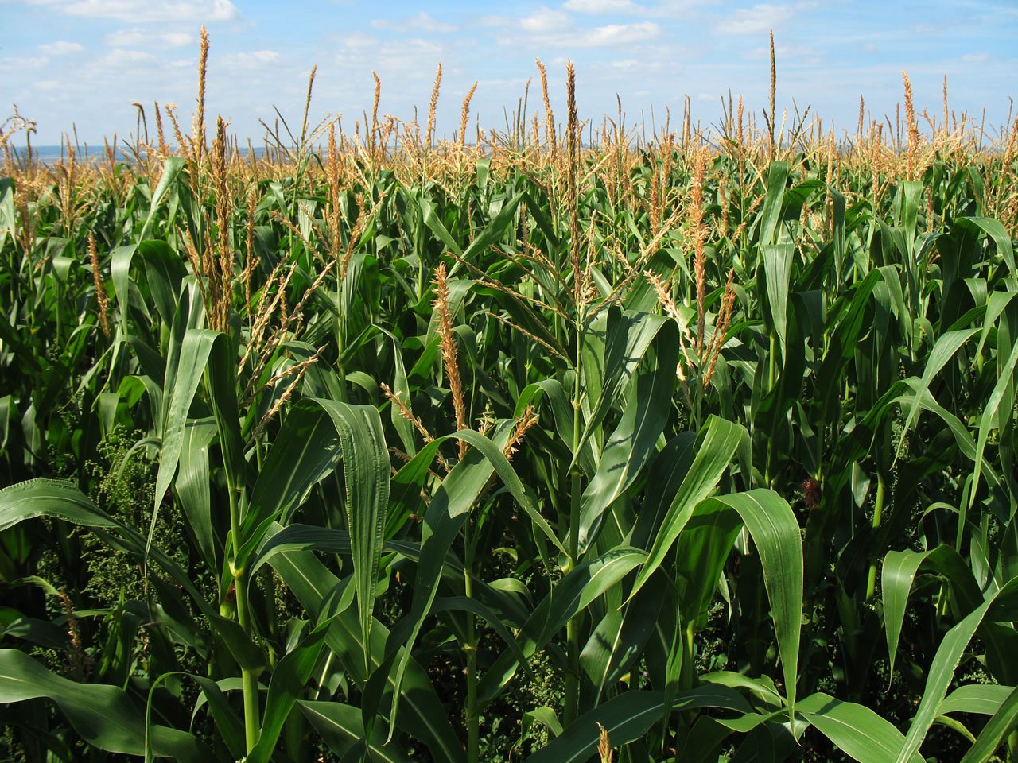
Specialty areas
Livestock and Natural Resources
Vet Sciences
Dairy
Forestry
Agronomy
Fruit trees
Nut crops
Viticulture
Environmental horticulture
Entomologist
Family and consumer sciences
Youth development
Ag Economics
Etc

Slide 10
http://ucanr.edu/
http://cemariposa.ucanr.edu/
Questions?

