Slide 1
Agri-Nature Entrepreneurship
Tara G. Schiff
Economic development specialist

Slide 2
Revolving Loan Program
Features & Benefits
Features
Great loans at low-interest, affordable rates.
Loans do not require a minimum credit score
Business assistance services.
Anyone can have an opportunity to receive a business loan, regardless of credit, length of operational time or other determining factors with a traditional business loan.
Benefits
Offers opportunity for prospective new business owners to establish commerce
Offer opportunities for existing businesses to grow, expand and prosper
Expanding and prosperous businesses help the Economic Sustainability of Mariposa County

Slide 3
Business Assistance - SBDC
Business Training Classes
Specialty Training
Restaurant
Retail
Local business consultant
Contact SBDC –
Jennifer Butler
Program Specialist, Valley Sierra SBDC (209) 386-1008 1735 M Street, Suite 111 Merced, CA 95340 jbutler@opportunitystanislaus.com

Slide 4
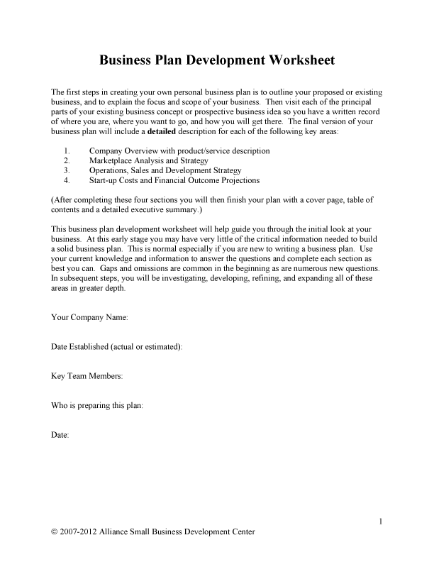
Business Plans/marketing plans

Slide 5
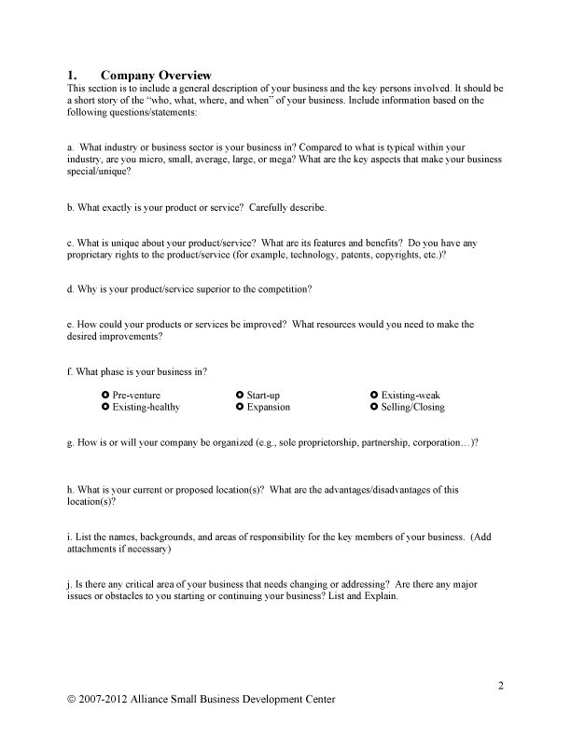
Business Plans/marketing plans

Slide 6
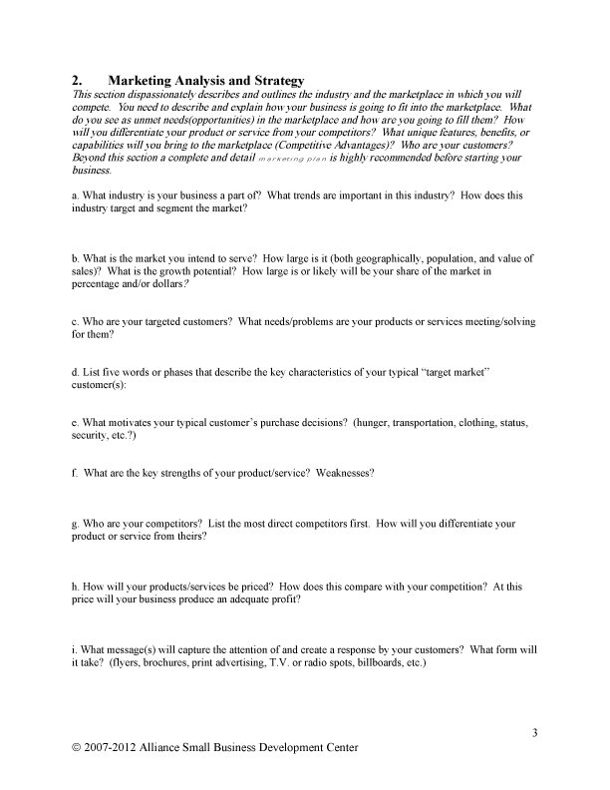
Business Plans/marketing plans

Slide 7
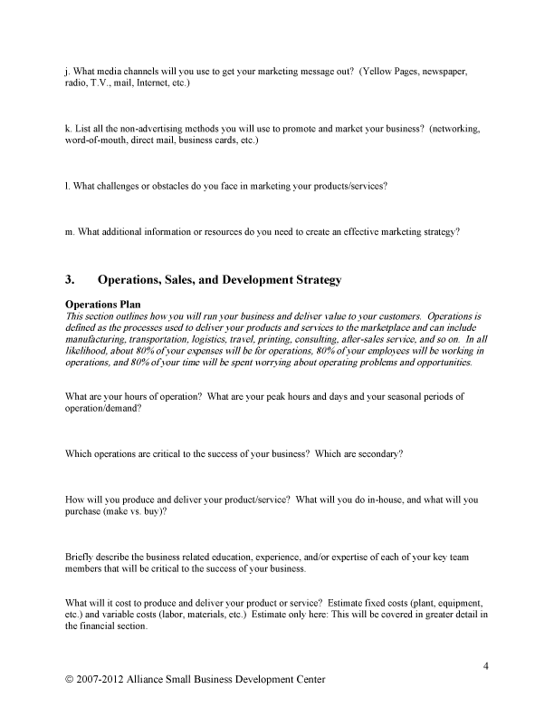
Business Plans/marketing plans

Slide 8
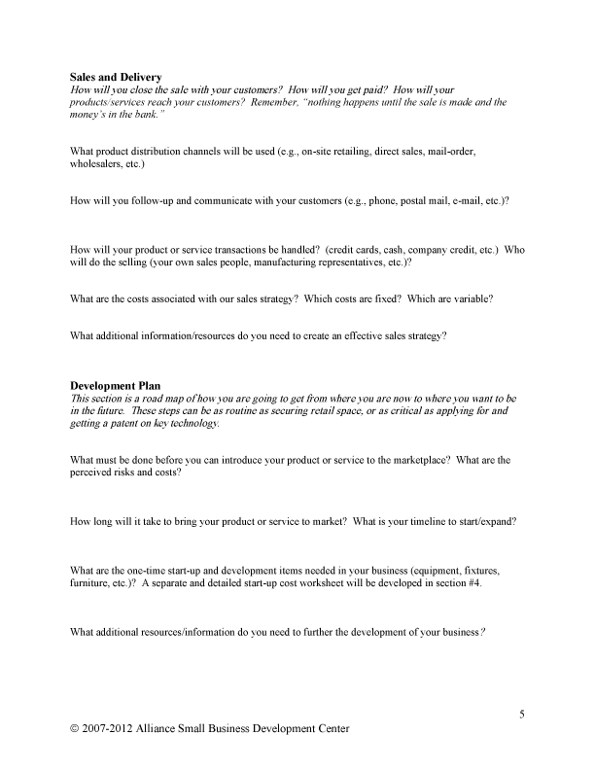
Business Plans/marketing plans

Slide 9
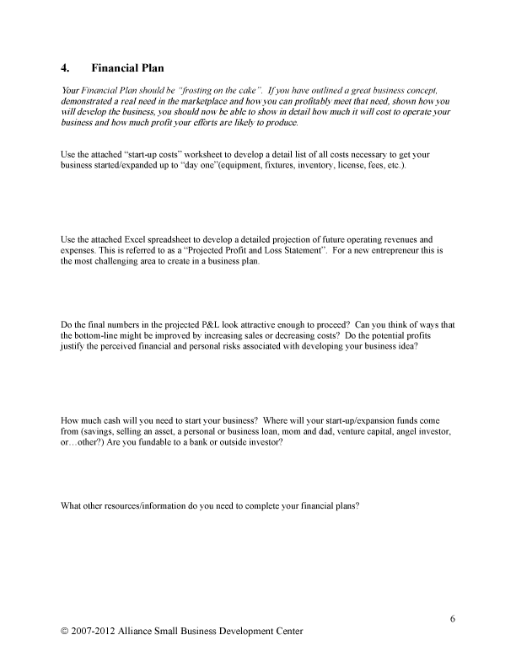
Business Plans/marketing plans

Slide 10
Business Plans/marketing plans

Slide 11
Business Plans/marketing plans

